Slide 1
Making of a NBA Player
GROUP MEMBERS
Aiyana Liz Mathew, Indira Tejaswini Vadlapatla & Kyle Kopacz

Slide 2
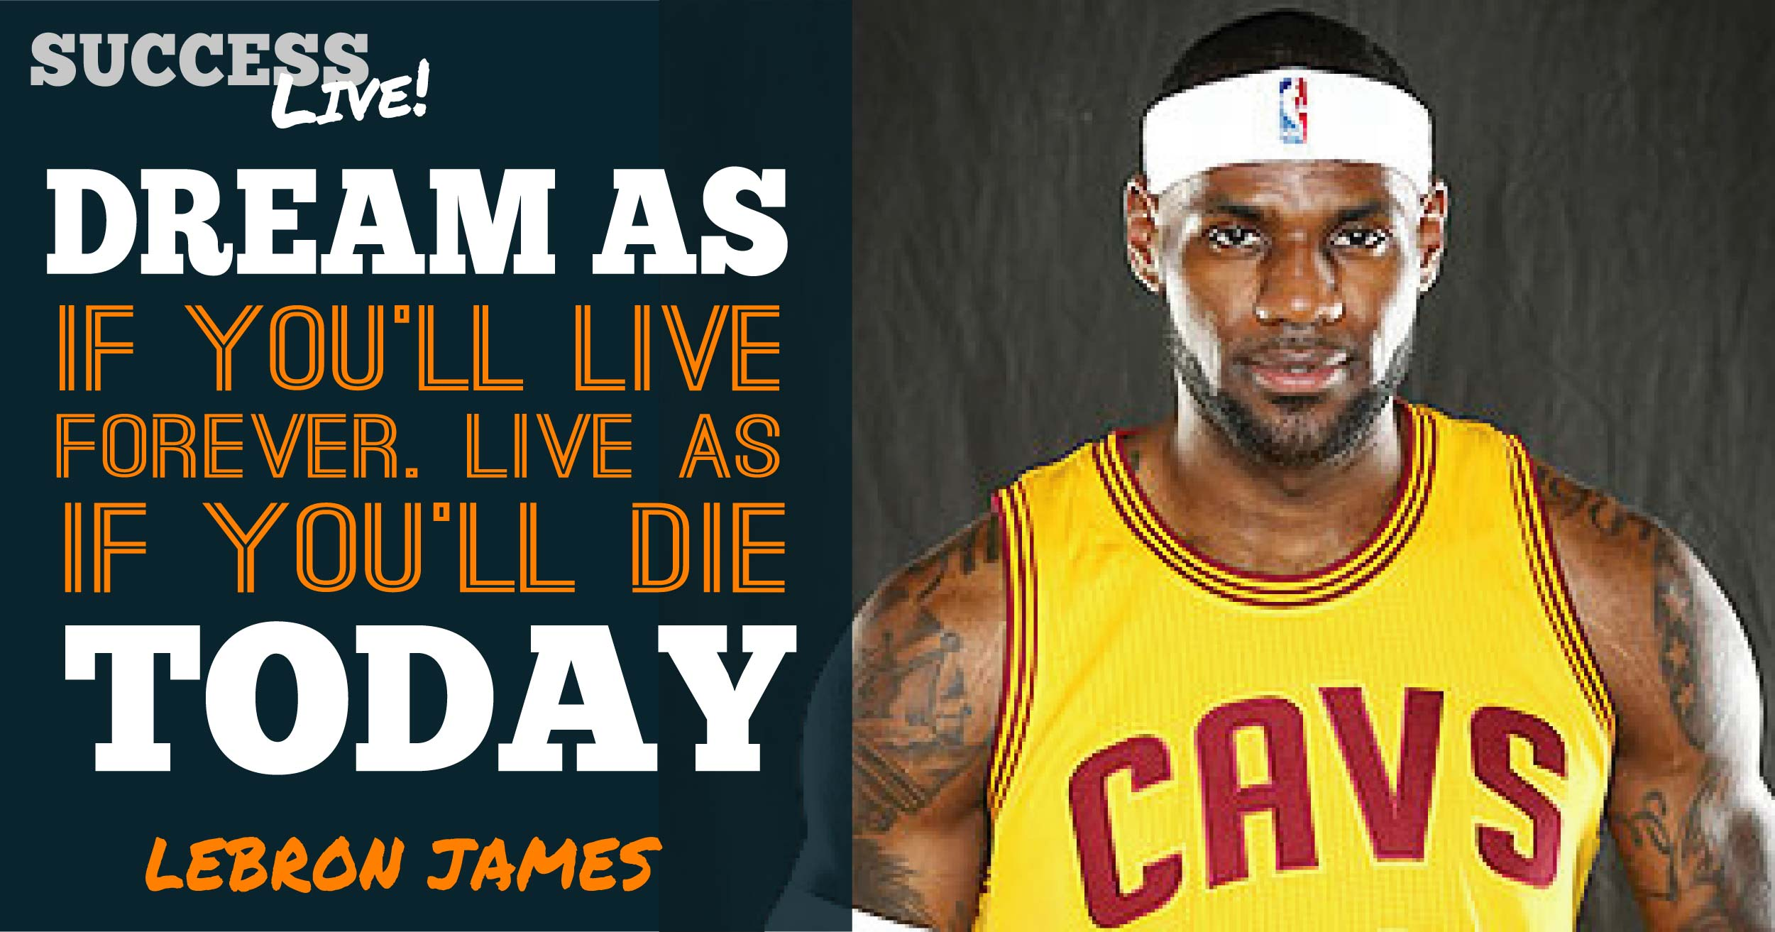
NOTE:
To change images on this slide, select a picture and delete it. Then click the Insert Picture icon
in the placeholder to insert your own image.

Slide 3
Technologies Used
Python
Flask
Mongo DB
HTML/CSS
Beautiful Soup
Javascript
D3
Charts.js
Treant.js
Plotly
Leaflet

Slide 4
Add a Slide Title - 2

Slide 5
Add a Slide Title - 3

